Slide 1

Modern Applications and Azure SQL Database
Jovan Popovic

Slide 2


Slide 3


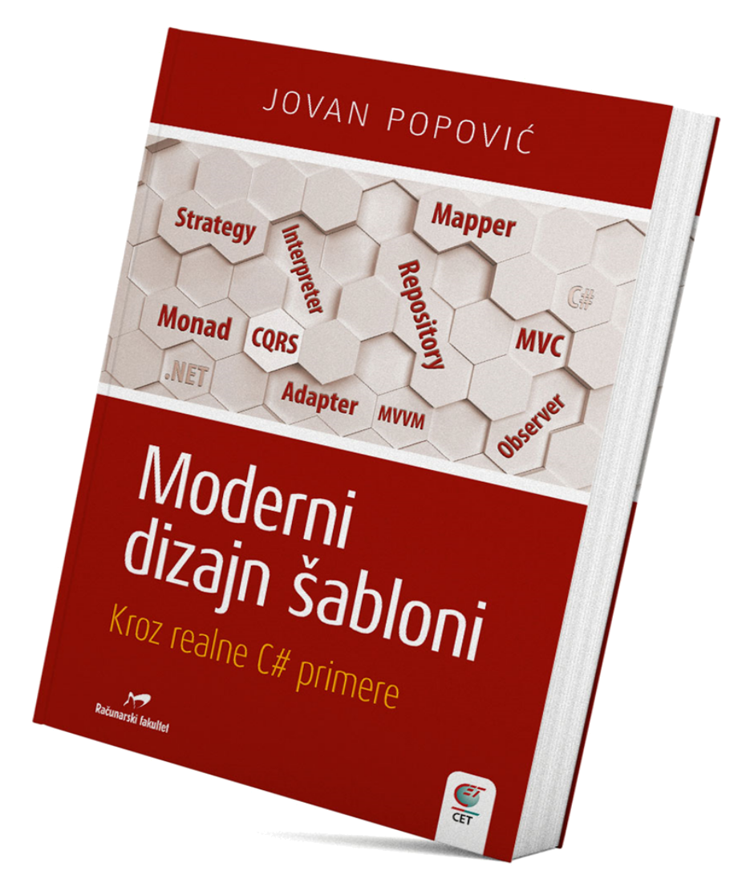


Who am I?
Senior Program Manager
Synapse Analytics, Azure SQL, SQL Server
Speaker
Pass Summit, SqlBits, SqlKonferenz
Tarabica, Sinergija
Book author
Blogger
Tech Community

Slide 4



What is modern?

Slide 5





Slide 6


Definition of modern
Stop doing unnecessary things
Stop wasting time
Finish your job easier
Work more efficiently
Do something that you never had chance to do

Slide 7
What is modern in Azure SQL?
Administration
Creation
Security
Geo-replication
Development
API
Microservices
Lambda architectures

Slide 8
Modern administration
Configuration
Security
Performance tuning

Slide 9
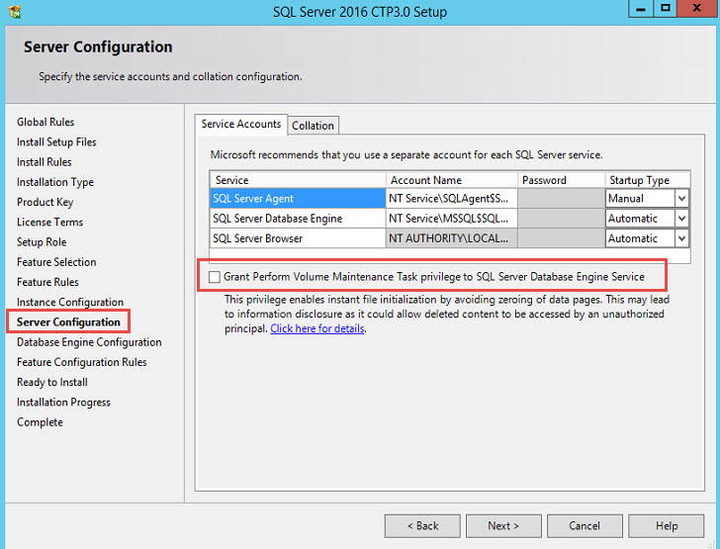
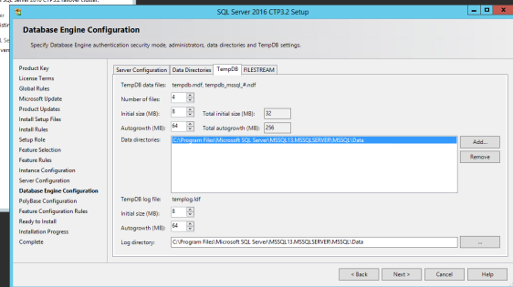
SQL Server Installation

Slide 10
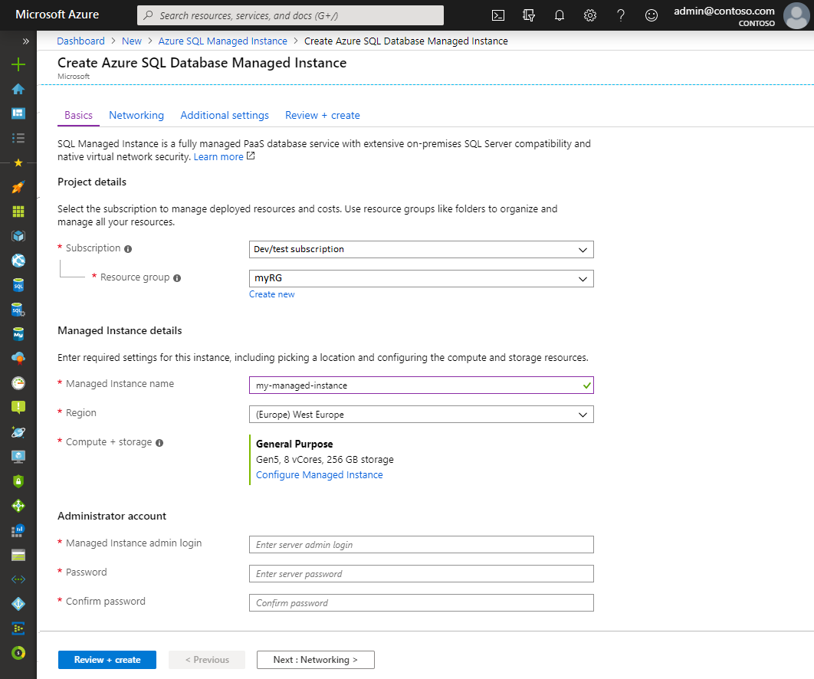
Azure SQL Deployment

Slide 11
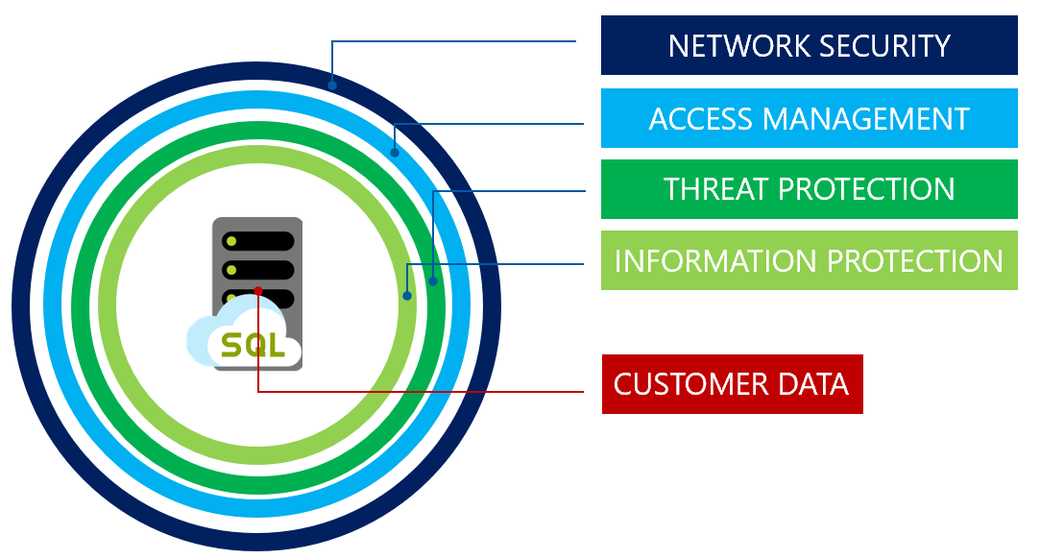
Azure SQL Security

Slide 12
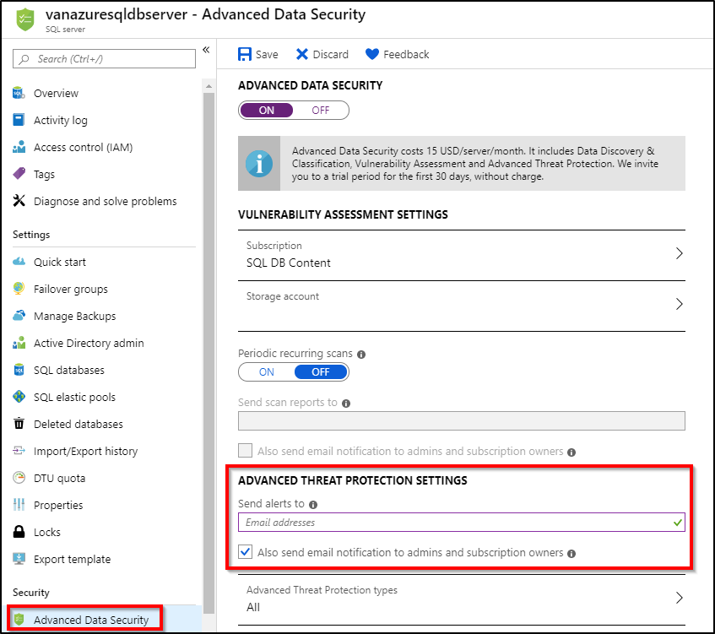
Security
Vulnerability assessment
Threat detection
Common threats
Alerting

Slide 13
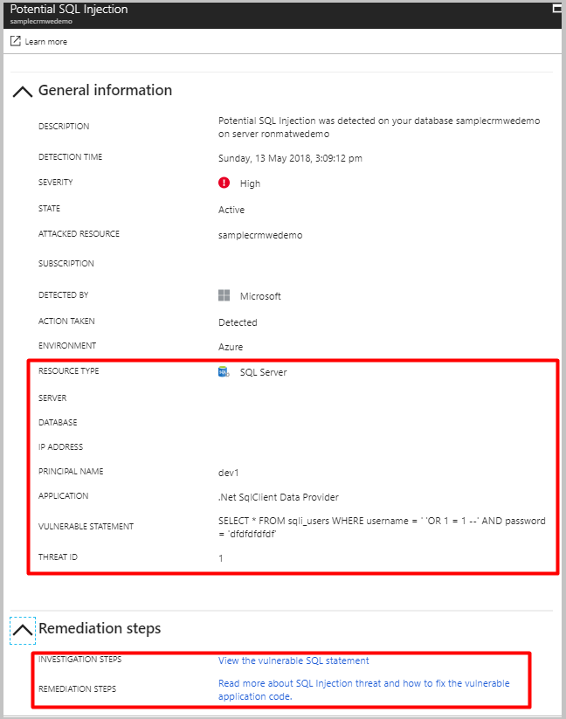
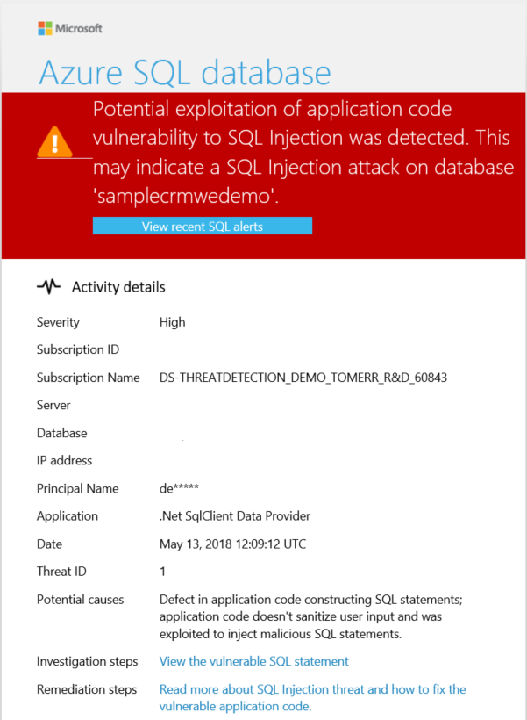
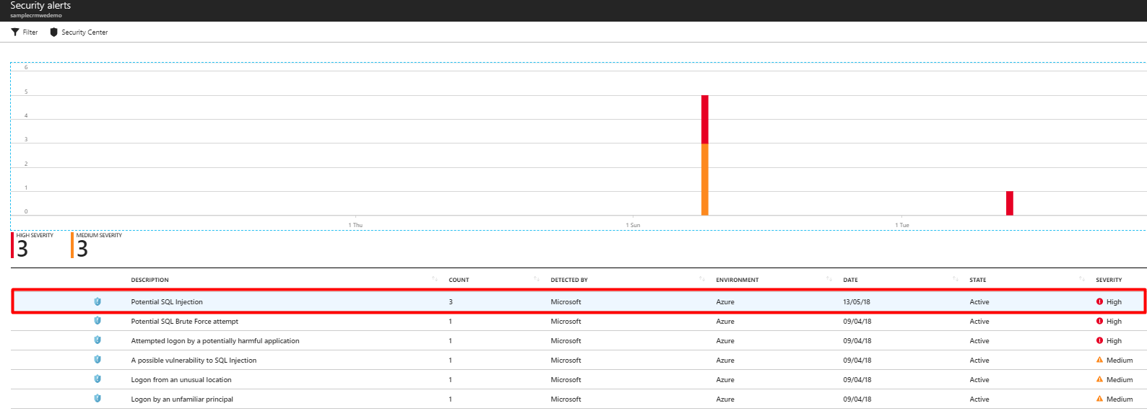
Email alerts
Built-in AI identifies common attack patterns
Automatic notification via email
Threat identification
Data discovery and classification

Slide 14
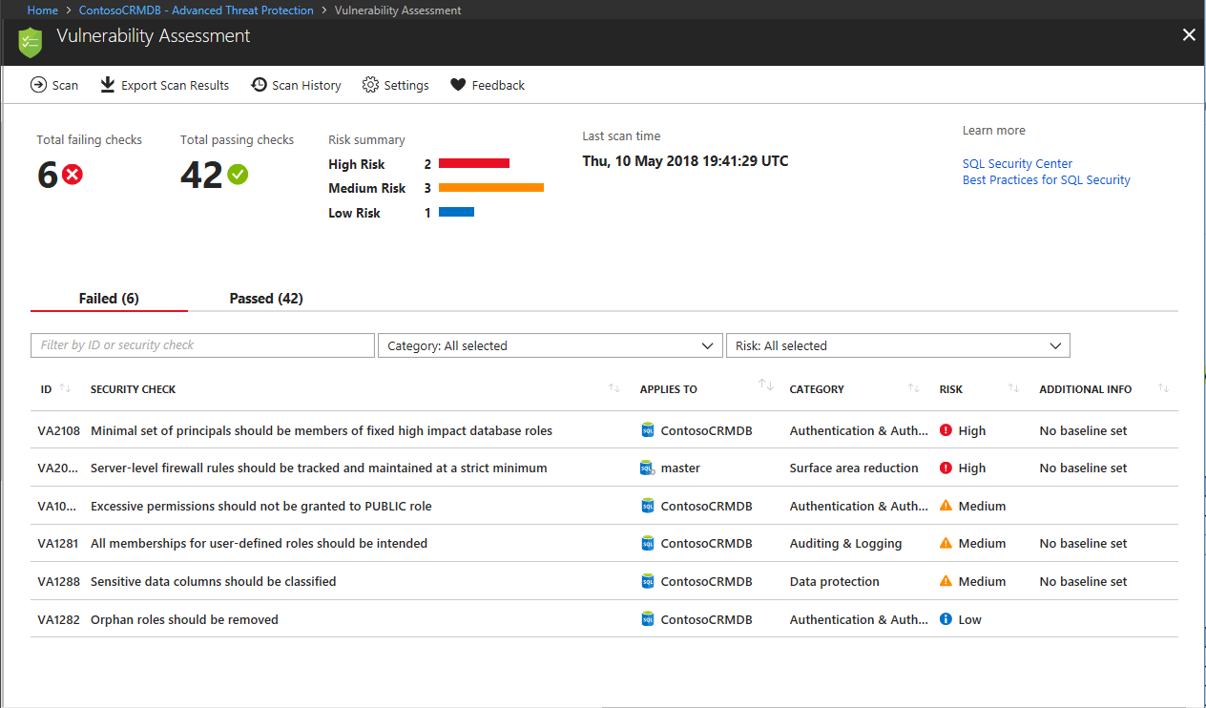

Slide 15
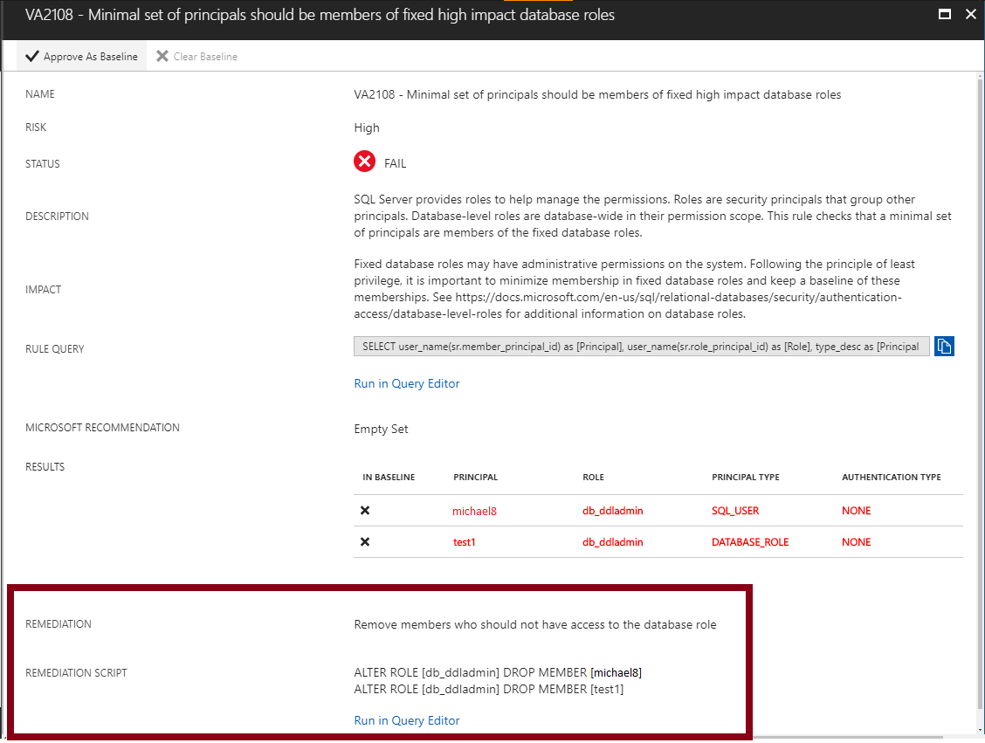

Slide 16
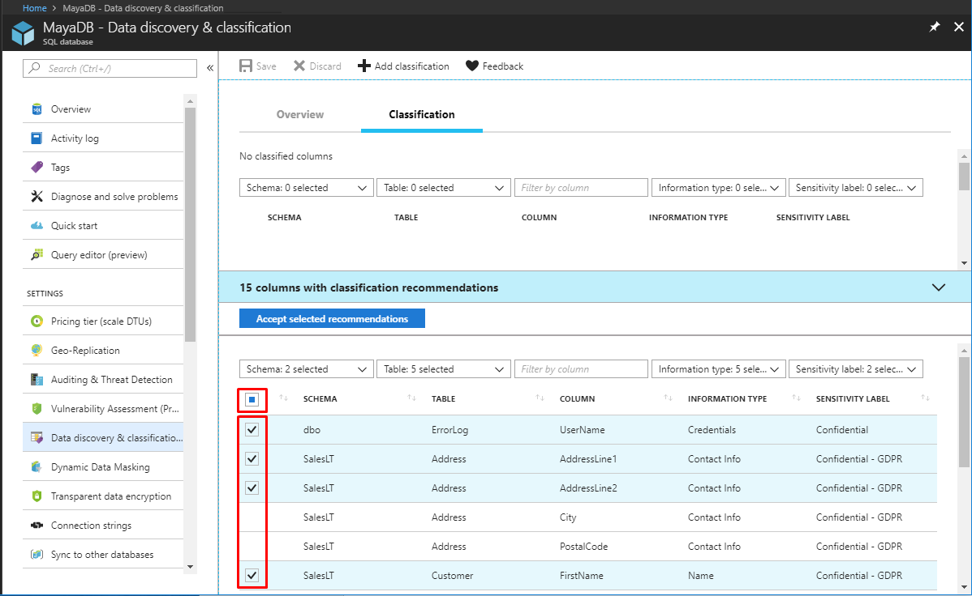

Slide 17
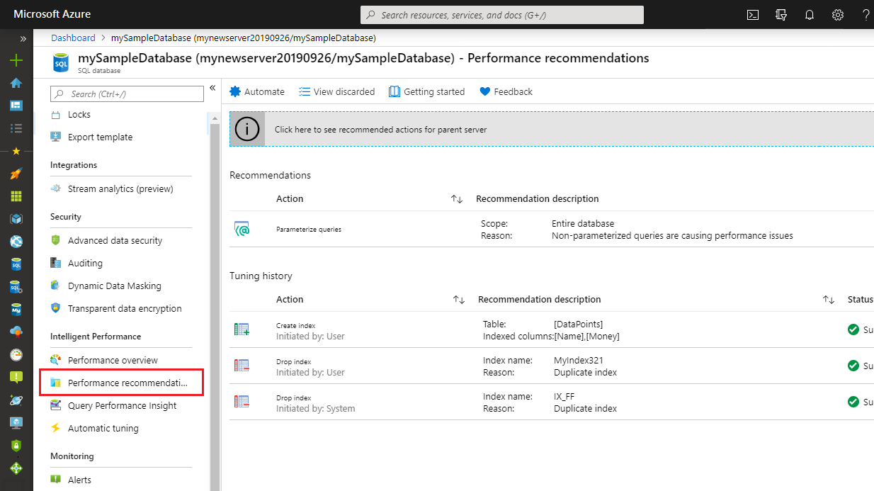

Slide 18
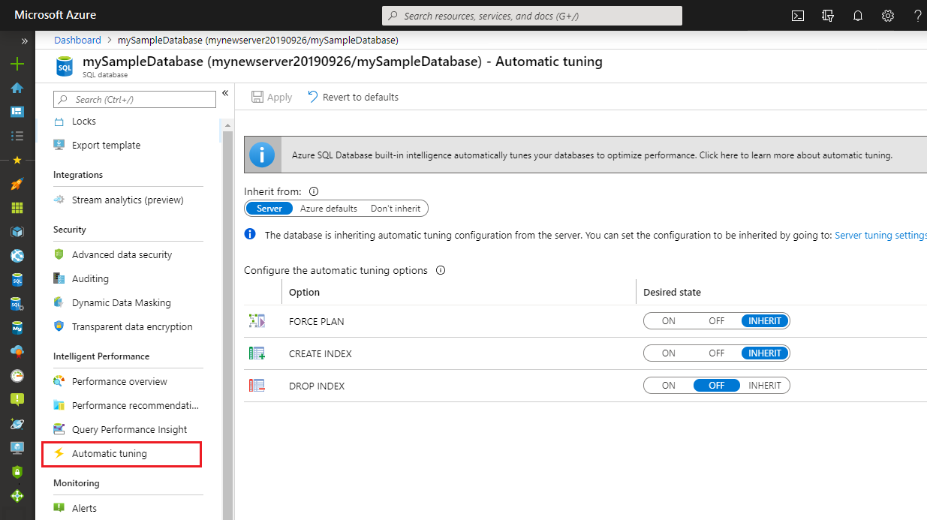

Slide 19
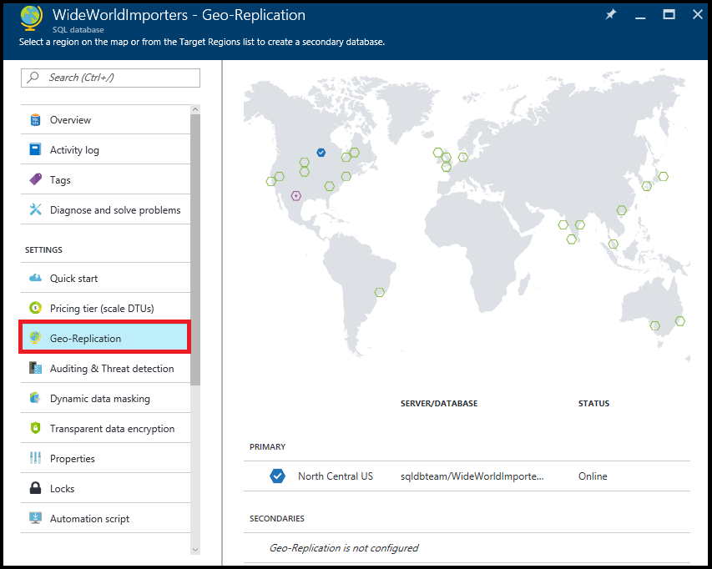
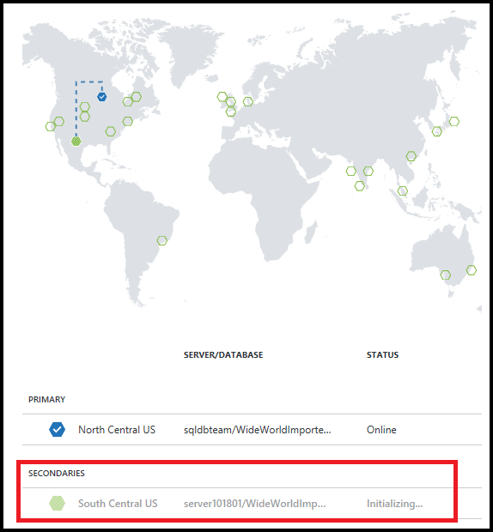
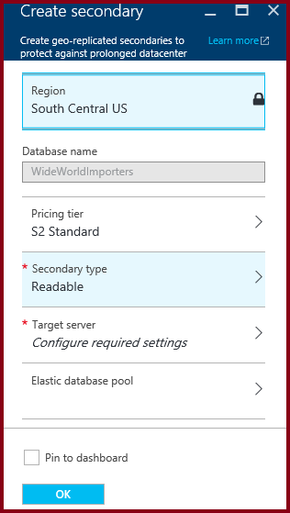
Replication

Slide 20
Modern application patterns
Powerful query language
Multi modal capabilities
API
IoT/Streaming/Log analytics

Slide 21
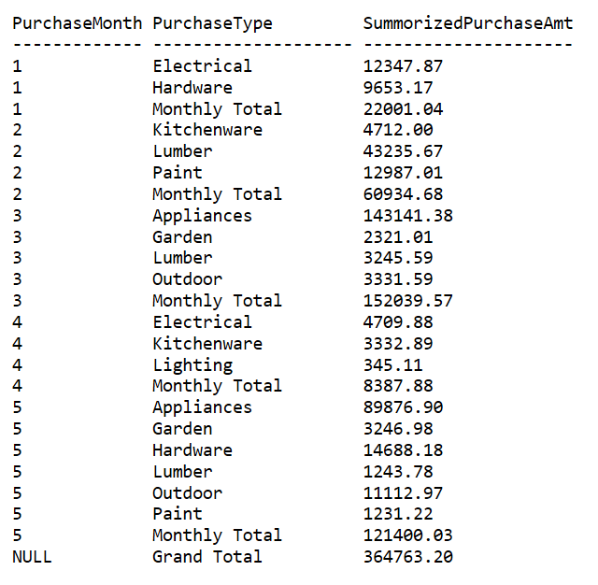
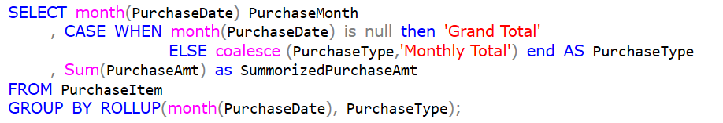
SQL – query language

Slide 22
Data access choice
using(var dbctx = new WWImportersContext()) {
var res = dbctx.Orders
.Include("Customer")
.Select (o => new {o.OrderID,o.OrderDate,o.Customer.CustomerName})
.ToList();
}
using (var cnn = new SqlConnection( "Server")) { return orders = cnn.Query<Order>("SELECT TOP 10 * FROM Sales.Orders");
}

Slide 23
Multi-model capabilities
JSON
De-normalization
Graph
Neo4J query
Spatial
Spatial queries
XML
Native type
Parsing
Export
Shortest path
Import
Export
Index
Querying
XQuery/XPath
Indexing
SRID

Slide 24
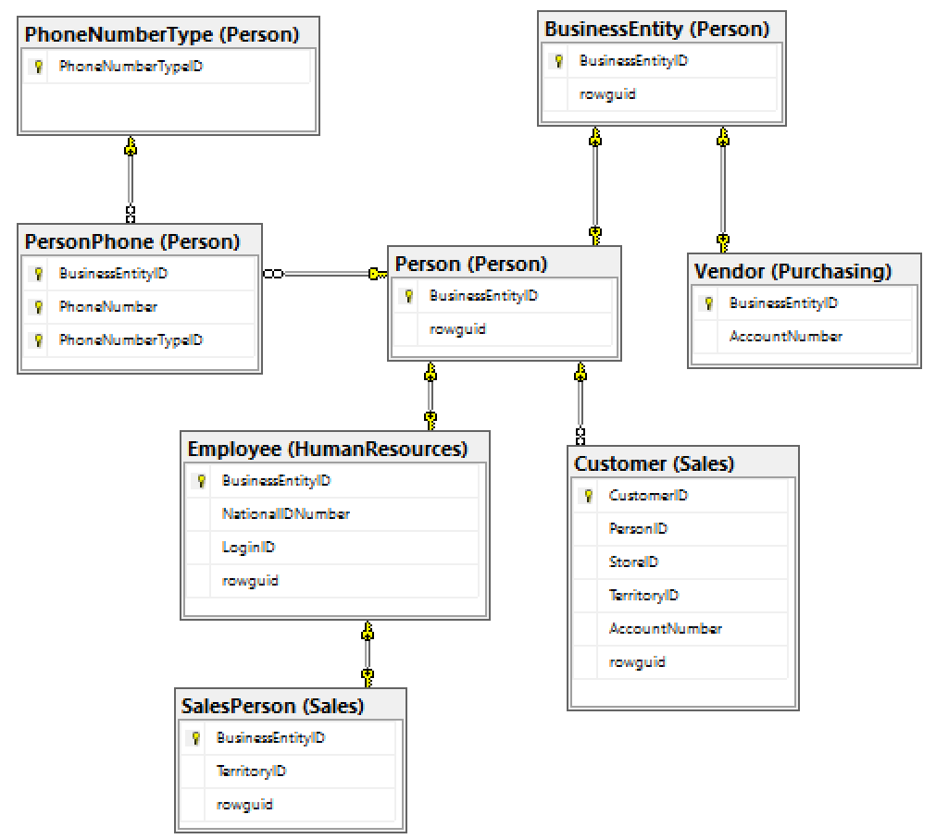
Classic: Normalization
Inheritance
Multiple table inheritance
Singe table inheritance
Arrays and collections
Emails, phones
Tags, keywords
Scenario
Product catalog
Survey data
Person info
Settings, prefferences

Slide 25
Combine relational and JSON data
ID | Name | Type | Price | Tags | Data
1 | Bike | 1 | 399.99 | [“promo”] | {“Gears”:20, “Weight”:9.5,”Gender”:”M”}
2 | Helmet | 7 | 120.99 | [“promo”,”sales”] | {“Visor”:true, “WxDxH”: [32,26.4,22]}
3 | Car | 6 | 29,500 |  | {“Doors”:4, “Seats”:5, “MPG”:29}
8 | Bike | 1 | 299.99 | [“sales”] | {“Tyres”:[“300c”,”35C”],Weight”:9.5,”Gender”:”M”}
9 | Car | 6 | 29,500 | [“promo”] | {“Doors”:2, “Seats”:2, “MPG”:35}
SELECT ProductID, Name, Tags, JSON_VALUE(Data, '$.Weight')
FROM Product
WHERE Type=1 AND JSON_VALUE(Data, '$.Gender') = 'F'
ORDER BY Price, CAST(JSON_VALUE(Data, '$.Weight') as float)

Slide 26

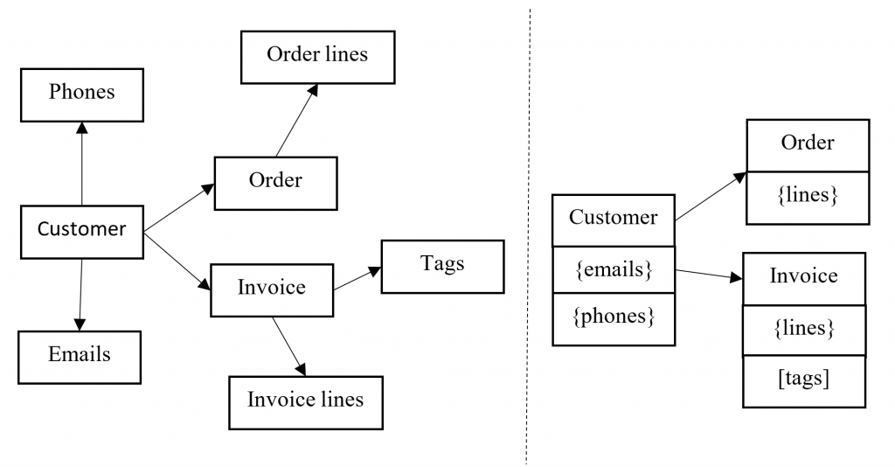
Choice: Hybrid model

Slide 27

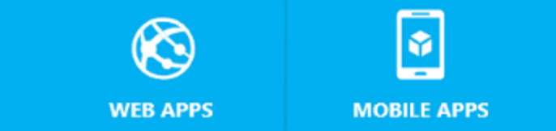


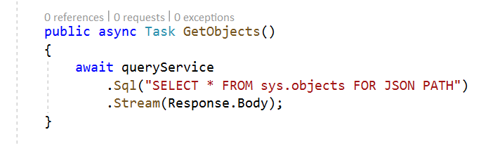


Simplify data access code
Id | Title | Data | Tags
1 | Bike | {….} | […]
2 | Helmet | {….} | […]
{ }
View Model
ORM
{ }

Slide 28
Microservices architecture

Slide 29
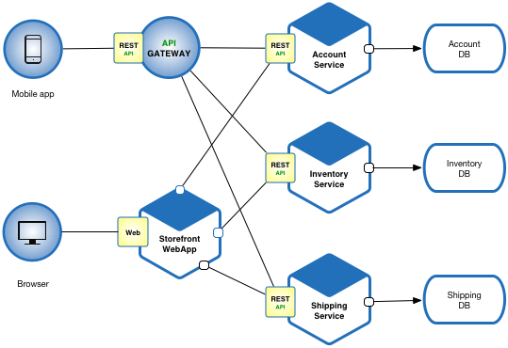
Microservice architecture
Azure PaaS is the best environment for Microservices
Azure API Management
Azure Functions
Azure SQL Database

Slide 30
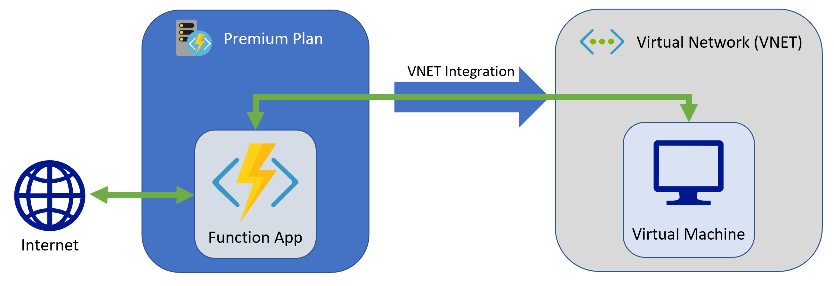

Microservices
Micro-service
Resource model
Serverless
Azure function
Azure SQL Serverless
Reserved
Azure App
Azure SQL
Infrastructure
Public cloud
Private link
VNet integration

Slide 31
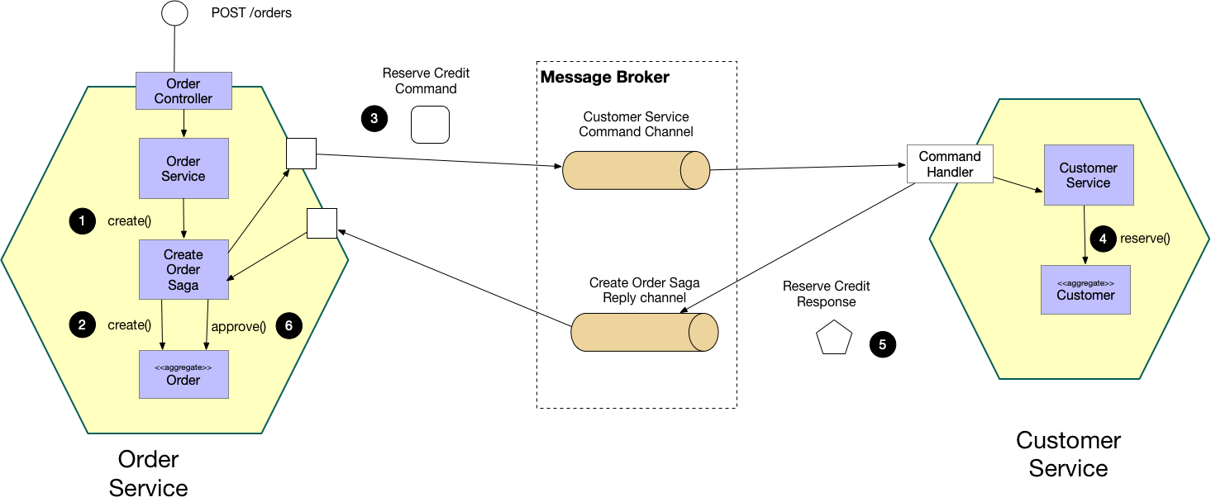
Saga pattern

Slide 32
Why do we need Saga?
using (var scope = new TransactionScope())
{
using (var orderRepository = dbCtx.CreateOrderRepository())
{
orderRepository.Insert( order);
}
using(var customerRepository = dbCtx.CreateCustomerRepository())
{
customerRepository.CreateInvoice(order.Price, order.CustomerId);
}
scope.Complete();
}

Slide 33
Azure SQL – Global Transactions
using (var scope = new TransactionScope())
{
using (var orderRepository = db1Ctx.CreateOrderRepository())
{
orderRepository.Insert( order);
}
using(var customerRepository = db2Ctx.CreateCustomerRepository())
{
customerRepository.CreateInvoice(order.Price, order.CustomerId);
}
scope.Complete();
}

Slide 34
IoT architectures

Slide 35
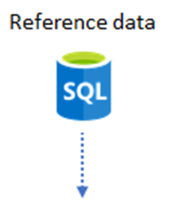
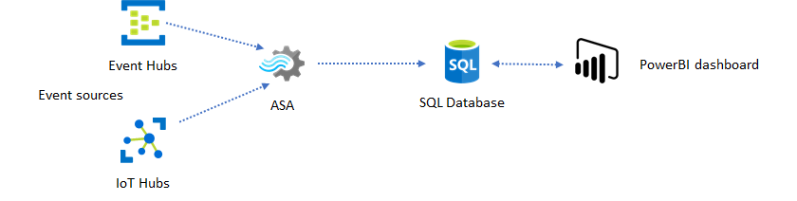
Streaming architectures

Slide 36
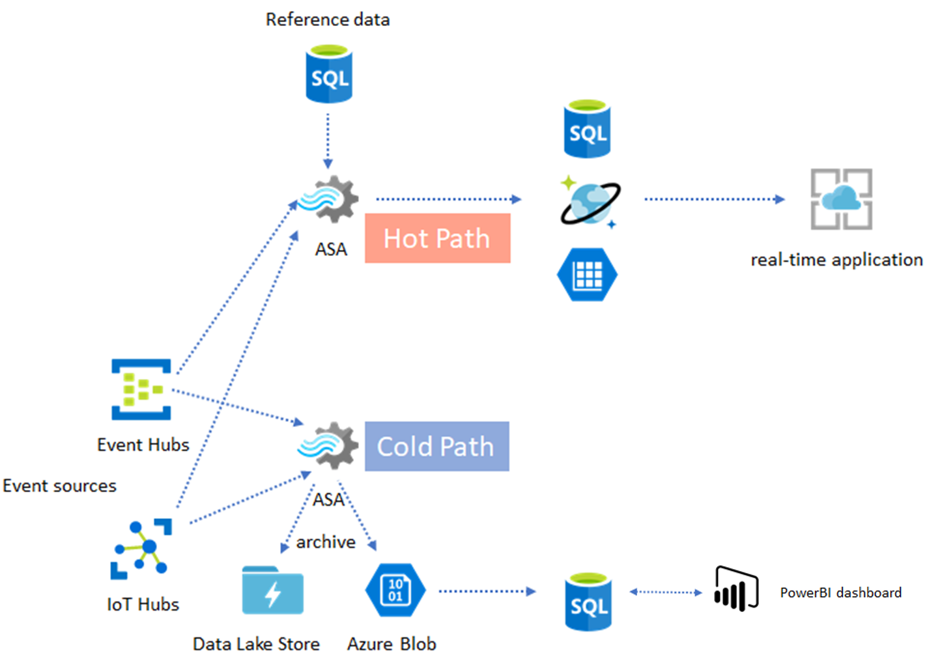
Lambda architecture

Slide 37



Azure Storage analytics
T-SQL can read Azure storage files
OPENROWSET(BULK)
External tables
Data file formats
CSV
Parquet
…

Slide 38
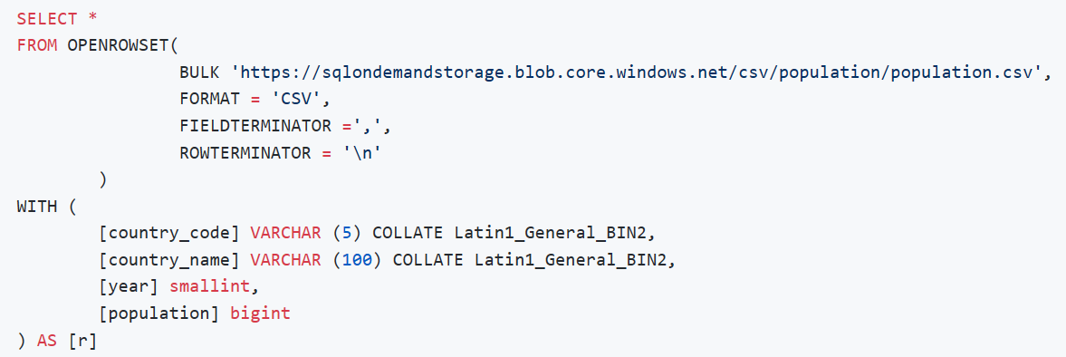
Analyze data on storage

Slide 39
Conclusion
Azure SQL is excellent choice for modern applications
Pro-active & intelligent databases system
Various choices for data access and design
Integrated in modern cloud solutions

